Slide 1
Diffusion Model
Training and Inference

Slide 2
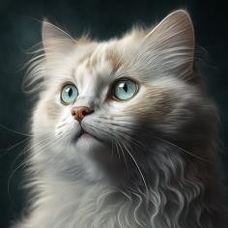
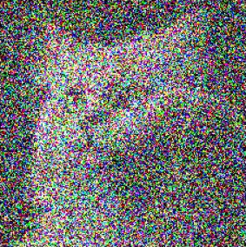

Intuition
Forward Process
Add noise
Add noise
Reverse Process
Denoise
Denoise

Slide 3

VAE vs. Diffusion Model
VAE
Encoder
Decoder
X N
Add noise X N
Diffusion
Denoise

Slide 4
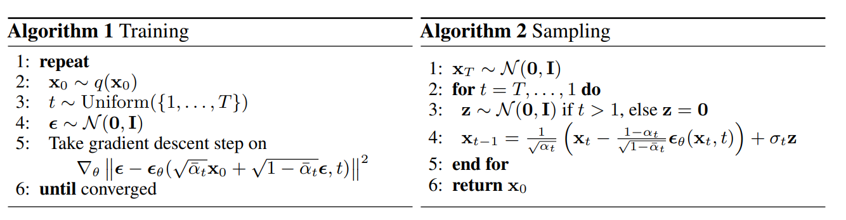
Denoising Diffusion Probabilistic Models

Slide 5
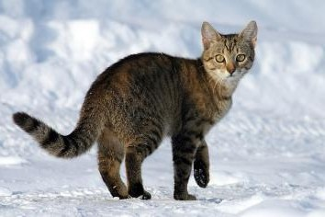

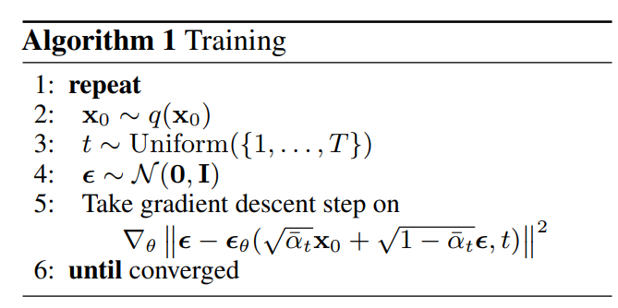

Training
𝑥₀: clean image
𝜀: noise
sample clean image
sample a noise
Noisy image
Target Noise
Noise predictor

Slide 6
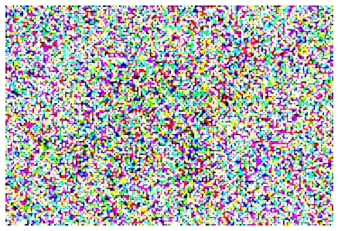


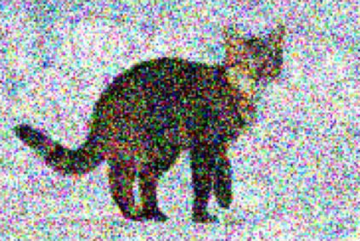



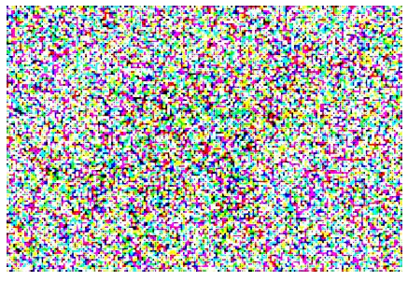
Training
Sample 𝑡
𝑥₀
𝜀
+
=
𝑥₀
𝜀
Noise Predicter
?????
t
𝜀

Slide 7


Thinking …
……
+
+
input ground truth
Random sample
Step 1
Step 2
input
=
In reality …
𝑥₀
𝜀 ground truth
input

Slide 8
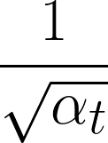
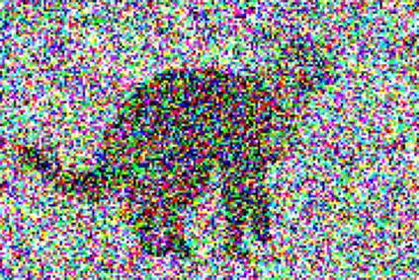
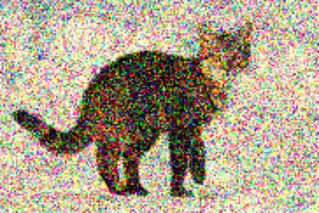


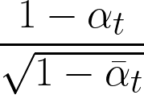



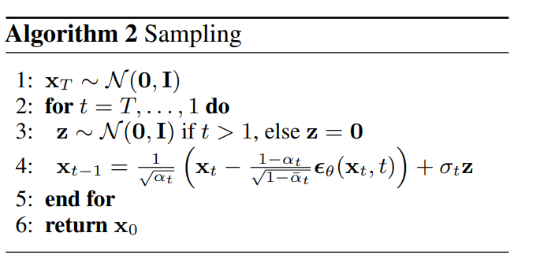
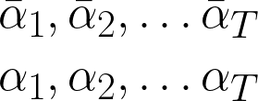
Inference
-
+
𝑥
𝑥
𝑡
𝑡−1
Noise Predicter
𝑡
𝑧
sample a noise?!
𝑥_{𝑇}

Slide 9
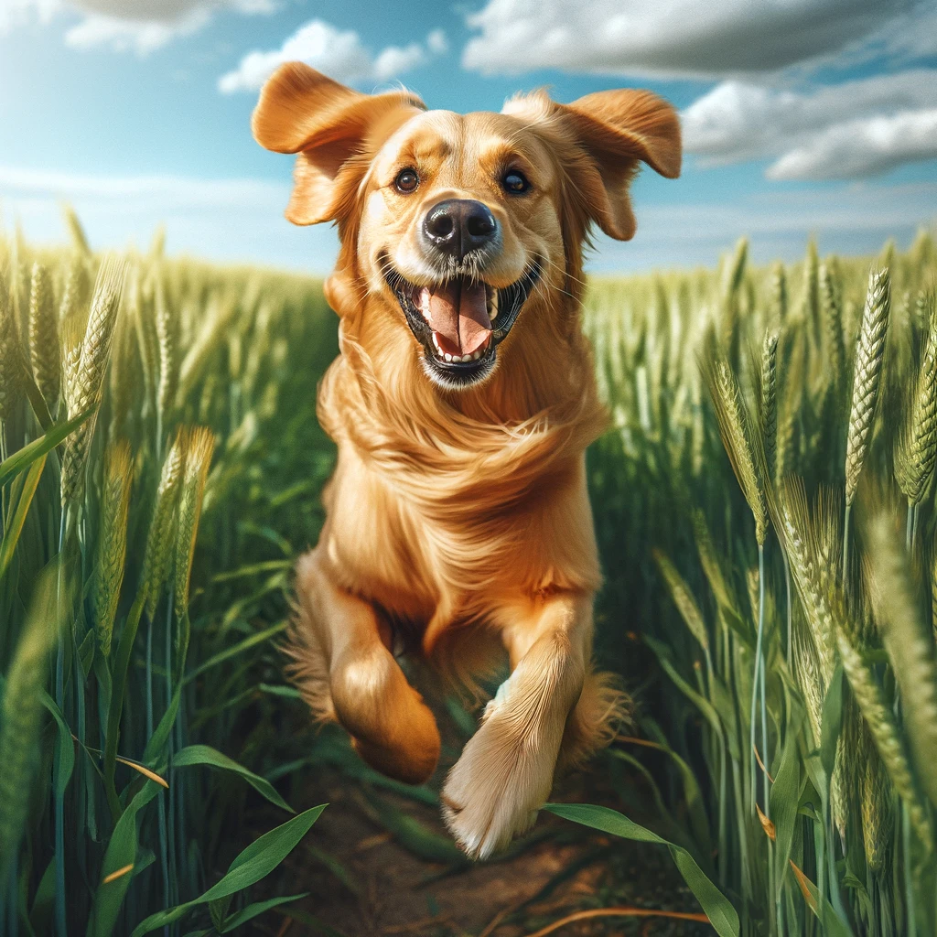
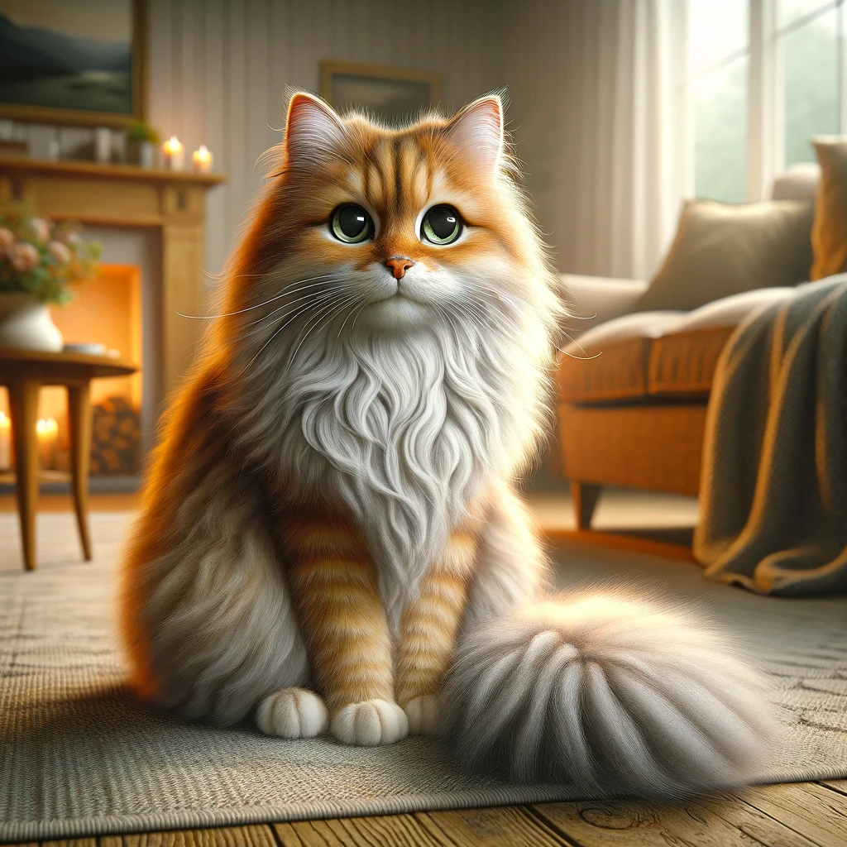















The goal of image generation
Real Image
𝑧
𝑥
Network

Slide 10
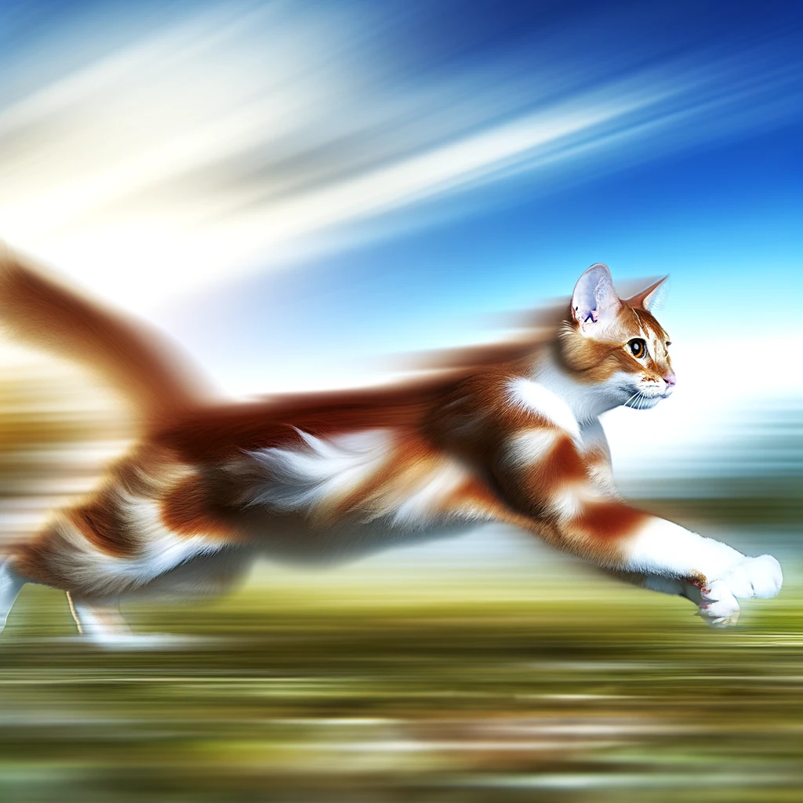
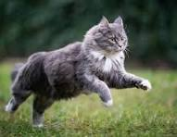
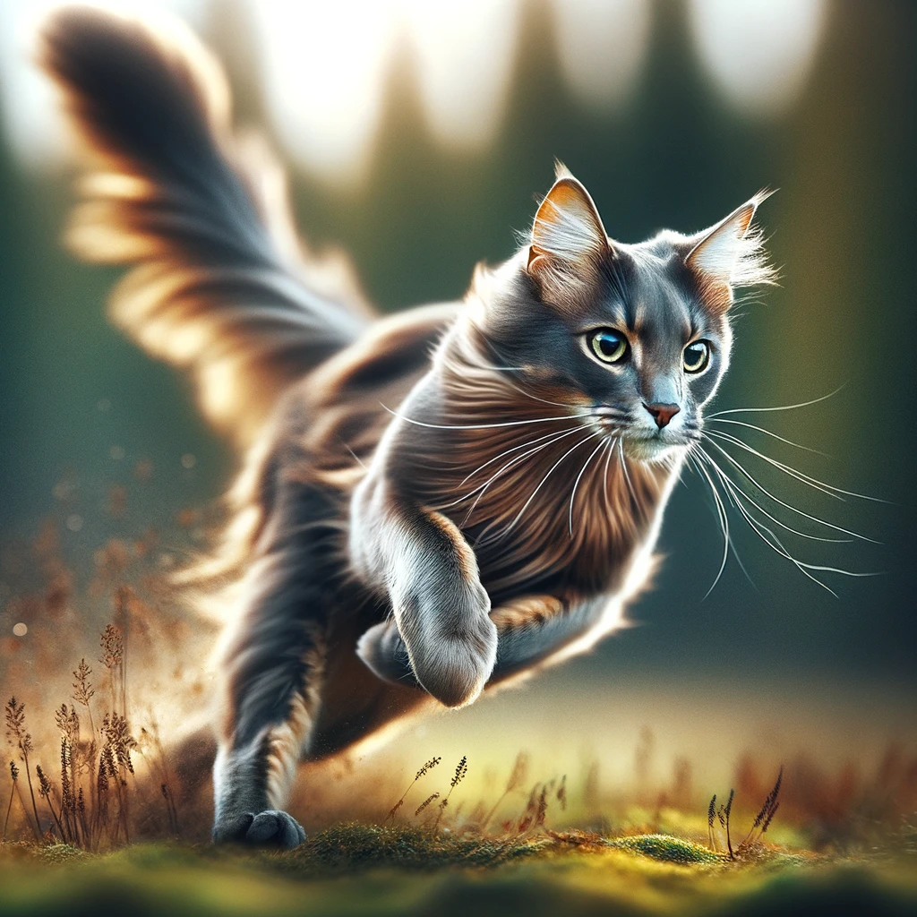
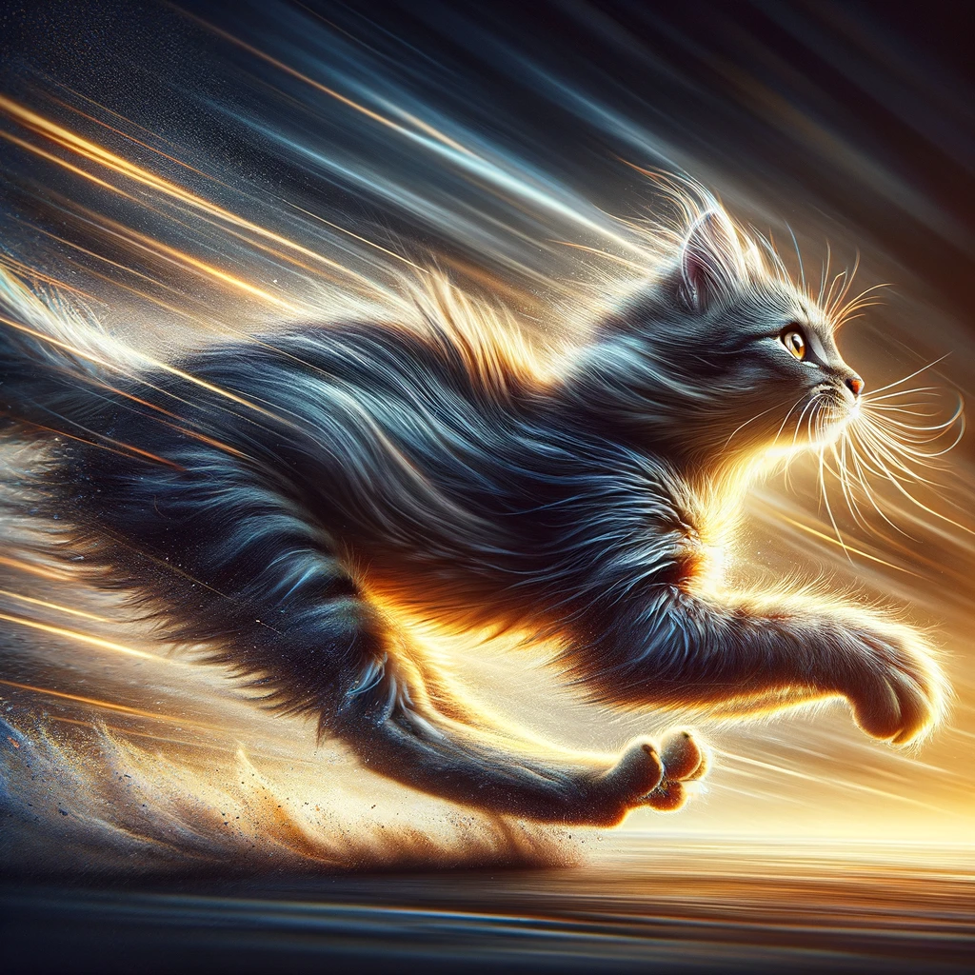
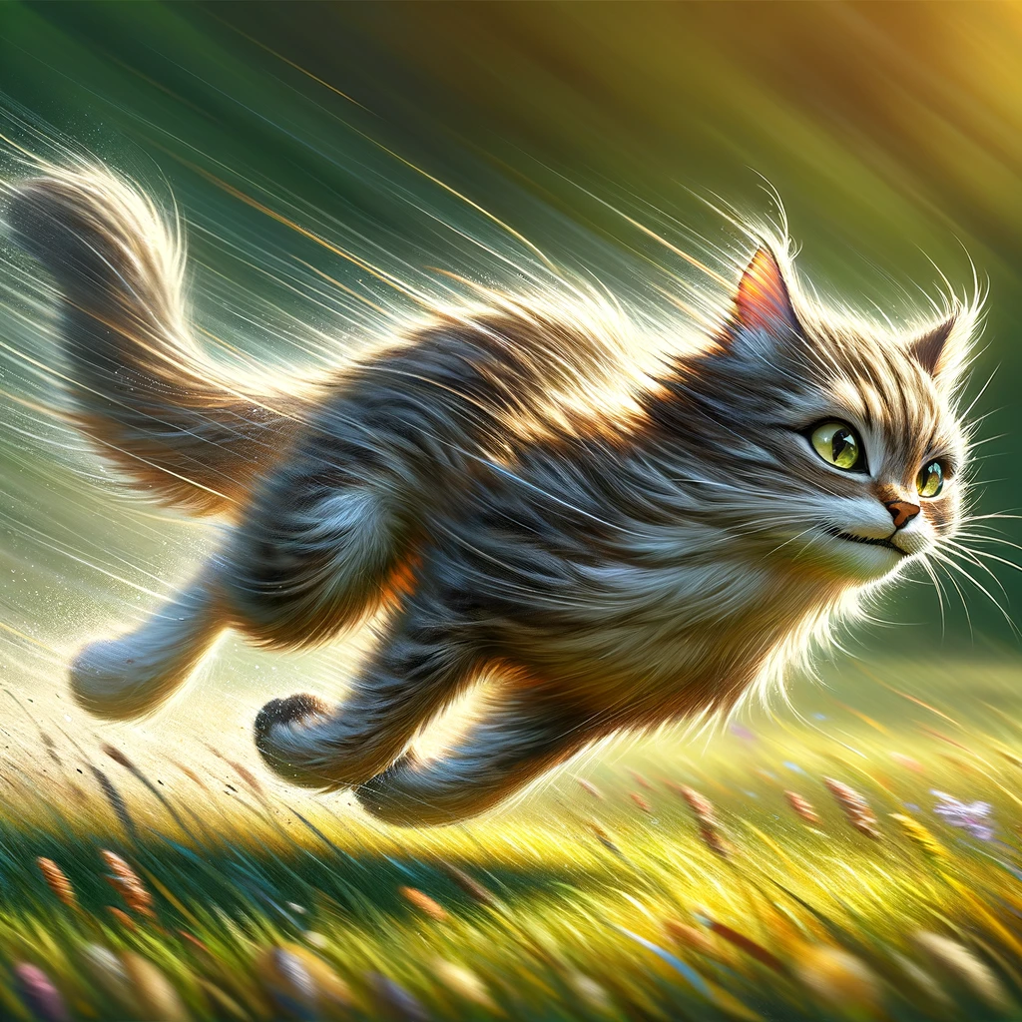
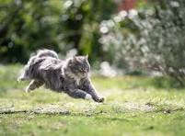
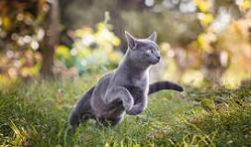
The goal of image generation
Real Image
𝑧
Network
𝑥
“A running cat”
(Condition)

